Slide 1
Credit Card Fraud Detection Using Machine Learning
Souvik Dey, RA1911029010017
Batch ID:NWC017043
Supervisor and Designation:
Dr.T.Preethiya

Slide 2
INDEX
Abstract
Introduction
Literature review
Existing Method
Drawbacks
Proposed method
Advantages
Implementation
Modules
Hardware and Software Requirements
Algorithms
UML Diagrams
Results
Conclusion
References

Slide 3
ABSTRACT
Fraud detection is an imp-ortant application for both the Online Payments Fraud Detection and banks and it is becoming a heated topic in research and industries. Many data mining techniques have been utilized in financial sys-tem to save consumers millions of dollars per year. In this study, we presented an Xgboost-based transaction fraud detection model with some feature engineering. The dataset is from Online Payments Fraud Detection Dataset Fraud Detection Compet-ition on Kaggle, which is a well-informed data science organi-zation. The study indicated that xgboost based model outperformed the other three methods including DecisionTreeClassifier, Logistic Regression and XGBoost. As to two feature selection methods, Xgboost performed better. Our best model achieved score on leader-board and defeated.
Keywords: DecisionTreeClassifier, Logistic Regression and XGBoost.

Slide 4
INTRODUCTION
Fraud is a billion-dollar business and it keeps increa-sing per year. Credit card is a nice target among many frauds since it is easy for attackers to steal the information of consumers and commit the fraud in a short time. Hence, many financial banks and insu-rance companies devoted millions of dollars to building a transaction detection system to prevent high risk transactions. The key component of the system is the detection algorithms, which mainly can be divided into two directions: clustering based methods and classification based methods. Apart from the powerful model, it is equally important to do data mining .Some techniques like feature selections, data cleaning and data visualization contribute to a good prediction. In this work, we used Xgboost as the classification model and take some data cleaning strategies to build up a fraud system. A. Related Work The term “data” mining is a process to find insights which are statistically reliable, unknown previously and valuable from data. In this task, the goal of it is to extract fraud patterns and knowledge from ordinary data. Then these fraud patterns can be used in further detection via clustering methods or classification methods.

Slide 5
LITERATURE REVIEW
S. No | Journal Type with year | Authors | Title | Outcomes
1 | IEEE, 2018 | Wang, M., Yu, J., & Ji, Z | Credit Fraud Risk Detection Based on XGBoost-LR Hybrid Model. | In this paper, Identification of personal fraud risk has become more crucial as the credit sector has grown in size. Banks and other financial firms may suffer huge losses if a model had a high accuracy rate.
2 | IEEE, 2017 | Carneiro, N., Figueira, G., & Costa, M. | A data mining based system for credit-card fraud detection in e-tail. Decision Support Systems | This paper can help researchers and practitioners to design and implement data mining based systems, as it describes the complete development process and addresses practical implementation issues
3 | Journal, 2019 | Saputra, Adi & Suharjito, Suharjito | Fraud Detection using Machine Learning in e-Commerce | This study applies the Synthetic Minority Over Sampling Technique (SMOTE) method to deal with class imbalances in the e-commerce transaction fraud dataset, the algorithm used is the decision tree, Naïve Bayes. random forest and neural network.
4 | ICDCN, 2020 | A. K. Rai and R. K. Dwivedi, | Fraud Detection in Credit Card Data using Unsupervised Machine Learning Based Scheme | In this paper, Here we presented a neural network based fraud detection scheme for fraud detection in credit card data in which unsupervised machine learning is used.

Slide 6
EXISTING METHOD
The increasing growth of machine learning, computer techniques divided into traditional methods and machine learning methods. This section describes the related works of Fraud Detection Using Machine Learning Model Detection and how machine learning methods are better than traditional methods. The existing method in this project have a certain flow is used for model development. Logistic Regression (LR) are used algorithms in existing system. But it requires large memory and result is not accurate.
DISADVANTAGES
Accuracy low
Requires more time
Difficult to handle

Slide 7
PROPOSED METHOD
Proposed several machine learning models model to classify Fraud are Not Fraud, but none have adequately addressed this misdiagnosis problem. That can be used for this purpose are Stevens Multi a Fraud Detection Using Machine Learning Model Detection. Also, similar studies that have proposed models for evaluation of such tumors mostly do not consider the heterogeneity and the size of the data Therefore, we propose a machine learning-based approach which combines a new technique of preprocessing the data for features transformation, DecisionTreeClassifier and XGBoost ML algorithm give the best accuracy techniques to eliminate the bias and the deviation of instability and performing classifier tests based.
Advantages:
Requires less time
Good Accuracy
Easy to handle

Slide 8
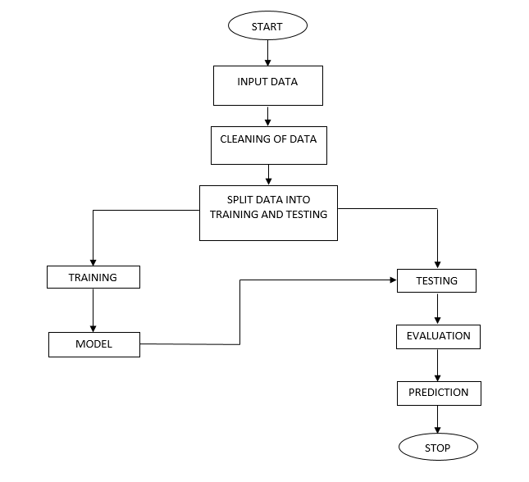
BLOCK DIAGRAM

Slide 9
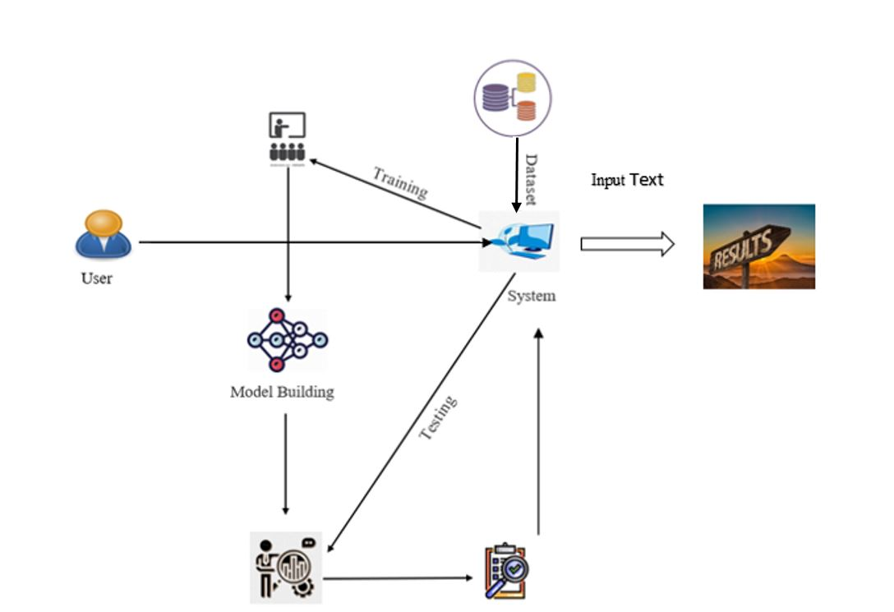
ARCHITECTURE

Slide 10
IMPLEMENTATION
First we have taken the Online Payments Fraud Detection of CSV file.
Load the dataset into work environment and made a check for null values if any.
After checking the null values split the data in to train data and test data.
After splitting apply the algorithm and fit the train data and test data.
We got the best accuracy score of XGBoost.
Later, the entire work is done with Django framework
User can view the Home, About, View page, Model training, Prediction.
After detection, we will get to know the Fraud Detection Using Machine Learning Model detection whether the result is Fraud are Not .

Slide 11
HARDWARE & SOFTWARE REQUIREMENTS
H/W Configuration:
• Processor - I3/Intel Processor
• Hard Disk -160GB
• RAM - 8Gb
S/W Configuration:
• Operating System : Windows 7/8/10 .
• IDE : Pycharm.
• Libraries Used : Numpy, Pandas, OS, Pillow, MySQL.
• Technology : Python 3.6+.

Slide 12
Algorithms
Decision Tree:
Decision tree learning is a supervised machine learning technique for inducing a decision tree from training data. A decision tree (also referred to as a classification tree or a reduction tree) is a predictive model which is a mapping from observations about an item to conclusions about its target value.
The goal of using a Decision Tree is to create a training model that can use to predict the class or value of the target variable by learning simple decision rules inferred from prior data (training data). In Decision Trees, for predicting a class label for a record we start from the root of the tree

Slide 13
LOGISTIC REGRESSION:
Logistic Regression was used in the biological sciences in early twentieth century. It was then used in many social science applications. Logistic Regression is used when the dependent variable (target) is categorical. For example,
To predict whether an email is spam (1) or (0)
Whether the tumor is malignant (1) or not (0)
Consider a scenario where we need to classify whether an email is spam or not. If we use linear regression for this problem, there is a need for setting up a threshold based on which classification can be done. Say if the actual class is malignant, predicted continuous value 0.4 and the threshold value is 0.5, the data point will be classified as not malignant which can lead to serious consequence in real time.
From this example, it can be inferred that linear regression is not suitable for classification problem. Linear regression is unbounded, and this brings logistic regression into picture. Their value strictly ranges from 0 to 1.

Slide 14
Neural Networks:
An artificial neural network (ANN) is the piece of a computing system designed to simulate the way the human brain analyzes and processes information. It is the foundation of artificial intelligence (AI) and solves problems that would prove impossible or difficult by human or statistical standards. ANNs have self-learning capabilities that enable them to produce better results as more data becomes available.
An ANN has hundreds or thousands of artificial neurons called processing units, which are interconnected by nodes. These processing units are made up of input and output units. The input units receive various forms and structures of information based on an internal weighting system, and the neural network attempts to learn about the information presented to produce one output report. Just like humans need rules and guidelines to come up with a result or output, ANNs also use a set of learning rules called backpropagation, an abbreviation for backward propagation of error, to perfect their output results.

Slide 15
XGBoost
XGBoost stands for “Extreme Gradient Boosting”. XGBoost is an optimized distributed gradient boosting library designed to be highly efficient, flexible and portable. It implements Machine Learning algorithms under the Gradient Boosting framework. It provides a parallel tree boosting to solve many data science problems in a fast and accurate way.
Boosting
Boosting is an ensemble learning technique to build a strong classifier from several weak classifiers in series. Boosting algorithms play a crucial role in dealing with Bias-variance trade-off. Unlike bagging algorithms, which only controls for high variance in a model, boosting controls both the aspects (bias & variance) and is considered to be more effective. Below are the few types of boosting algorithms:
AdaBoost (Adaptive Boosting)
Gradient Boosting
XGBoost
CatBoost
Light GBM

Slide 16
UML Diagrams
Uml stands for unified modeling language. Uml is a standardized general-purpose modeling language in the field of object-oriented software engineering. The standard is managed, and was created by, the object management group.
The goal is for uml to become a common language for creating models of object oriented computer software. In its current form uml is comprised of two major components: a meta-model and a notation. In the future, some form of method or process may also be added to; or associated with, uml.
The unified modeling language is a standard language for specifying, visualization, constructing and documenting the artifacts of software system, as well as for business modeling and other non-software systems.
The uml represents a collection of best engineering practices that have proven successful in the modeling of large and complex systems.
The uml is a very important part of developing objects oriented software and the software development process. The uml uses mostly graphical notations to express the design of software projects.

Slide 17
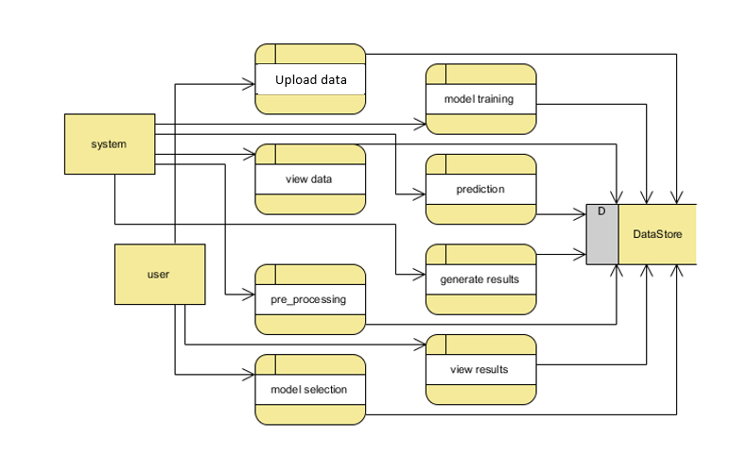
Achitecture Diagram:

Slide 18
Use case diagram:
A use case diagram in the unified modeling language (uml) is a type of behavioral diagram defined by and created from a use-case analysis. Its purpose is to present a graphical overview of the functionality provided by a system in terms of actors, their goals (represented as use cases), and any dependencies between those use cases. The main purpose of a use case diagram is to show what system functions are performed for which actor. Roles of the actors in the system can be depicted.

Slide 19
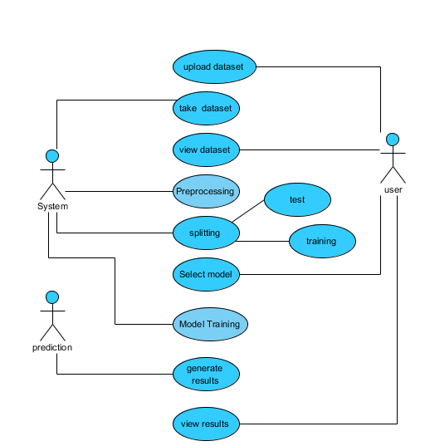

Slide 20
Class diagram:
In software engineering, a class diagram in the unified modeling language (uml) is a type of static structure diagram that describes the structure of a system by showing the system's classes, their attributes, operations (or methods), and the relationships among the classes. It explains which class contains information.

Slide 21
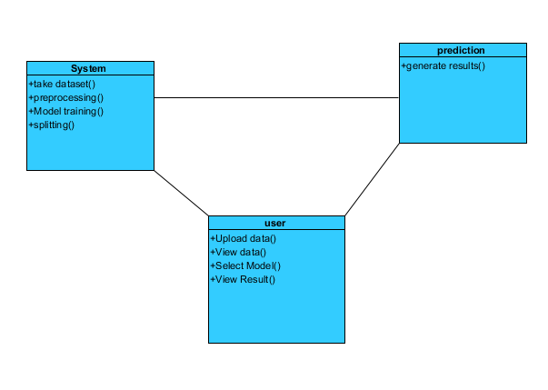

Slide 22
Sequence diagram:
A sequence diagram in unified modeling language (uml) is a kind of interaction diagram that shows how processes operate with one another and in what order. It is a construct of a message sequence chart. Sequence diagrams are sometimes called event diagrams, event scenarios, and timing diagrams.

Slide 23
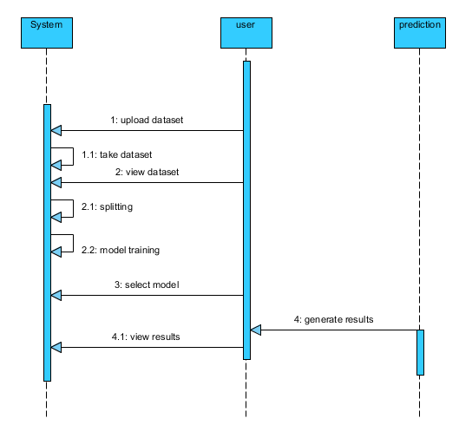

Slide 24
Collaboration diagram:
In collaboration diagram the method call sequence is indicated by some numbering technique as shown below. The number indicates how the methods are called one after another. We have taken the same order management system to describe the collaboration diagram. The method calls are similar to that of a sequence diagram. But the difference is that the sequence diagram does not describe the object organization whereas the collaboration diagram shows the object organization.

Slide 25
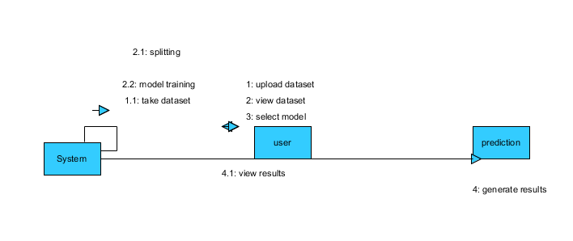

Slide 26
Deployment diagram:
Deployment diagram represents the deployment view of a system. It is related to the component diagram. Because the components are deployed using the deployment diagrams. A deployment diagram consists of nodes. Nodes are nothing but physical hard ware’s used to deploy the application.

Slide 27


Slide 28
Component diagram:
Component diagrams are used to describe the physical artifacts of a system. This artifact includes files, executable, libraries etc. So the purpose of this diagram is different, component diagrams are used during the implementation phase of an application. But it is prepared well in advance to visualize the implementation details. Initially the system is designed using different uml diagrams and then when the artifacts are ready component diagrams are used to get an idea of the implementation.

Slide 29
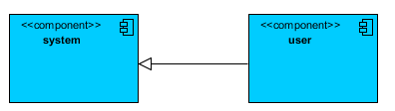

Slide 30
Activity diagram:
Activity diagrams are graphical representations of workflows of stepwise activities and actions with support for choice, iteration and concurrency. In the unified modeling language, activity diagrams can be used to describe the business and operational step-by-step workflows of components in a system. An activity diagram shows the overall flow of control.

Slide 31
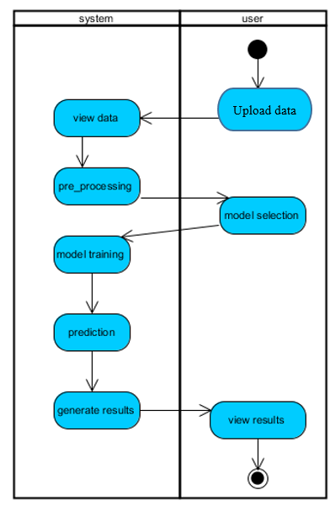

Slide 32
ER Diagram:
An Entity–relationship model (ER model) describes the structure of a database with the help of a diagram, which is known as Entity Relationship Diagram (ER Diagram). An ER model is a design or blueprint of a database that can later be implemented as a database. The main components of E-R model are: entity set and relationship set.

Slide 33
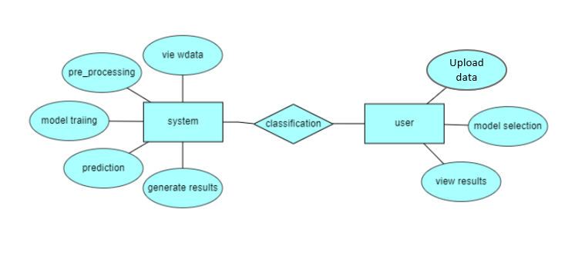

Slide 34
DFD Diagram:
A Data Flow Diagram (DFD) is a traditional way to visualize the information flows within a system. A neat and clear DFD can depict a good amount of the system requirements graphically. It can be manual, automated, or a combination of both. It shows how information enters and leaves the system, what changes the information and where information is stored. The purpose of a DFD is to show the scope and boundaries of a system as a whole. It may be used as a communications tool between a systems analyst and any person who plays a part in the system that acts as the starting point for redesigning a system.

Slide 35
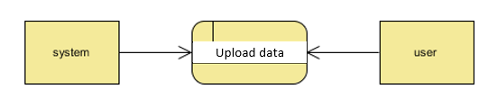
Context Level Diagram:

Slide 36
Thank You

